Slide 1

Decision Tree
GU Zhan (Sam)
1

Slide 2
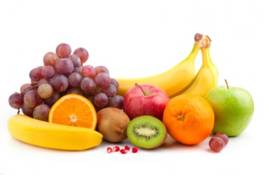
Decision Tree for fruit classification
grapefruit
Tree shows the alternative courses of action or casual consequences for a particular decision.
Condition/Rule based domain knowledge
A snapshot of the experts knowhow
yellow
Color?
round
orange
Shape?
orange
oval
acidic
kumquat
Smell?
apple
sweet
round
Shape?
pear
oval
no
Peels easily?
yes
banana

Slide 3
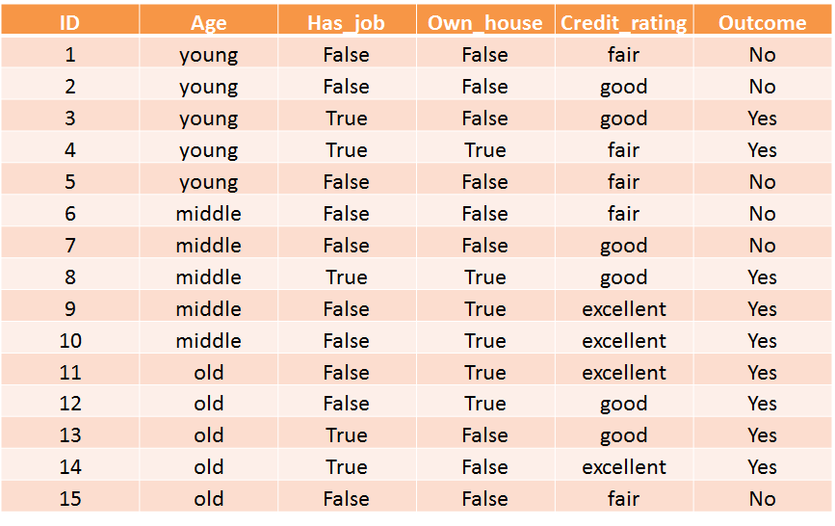
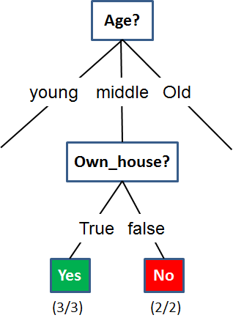
What is Decision Tree?
Decision Tree (DT) is a knowledge discovery method (supervised learning) used for classification and regression. The goal is to create a model (knowledge/rules) that predicts the value of a target variable by learning decision tree/rules inferred from the data features, through statistical calculation.

Slide 4
Rule Induction using Decision Tree
Bank Loan Example – Business Background
Banks receive many loan applications that has to be assessed for approval.
Each application consists of many factors such as Age, Job status, Housing, Credit history.
Some applications are approved, others are not; Some debtors default, others don’t.
Banks dislike defaulters. Banks want to approve only applicants who are unlikely to default.
Bank’s task is to predict if a new applicant will default or not.
This a classification problem: Approve projected non defaulter or Reject projected defaulter during loan application.

Slide 5
Rule Induction using Decision Tree
Bank Loan Example – Rule Induction Data Science

Slide 6
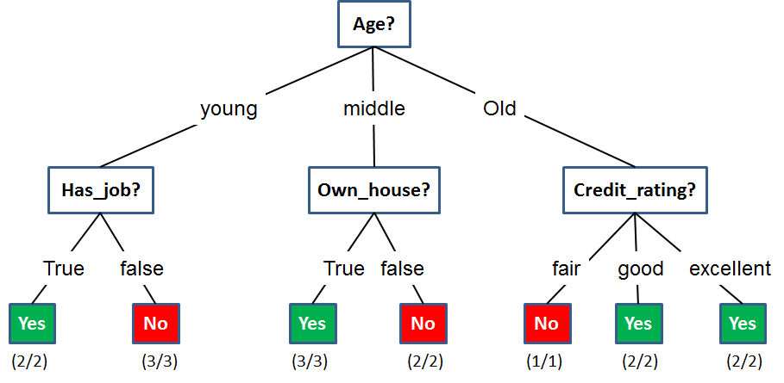
Rule Induction using Decision Tree
Bank Loan Example – Decision Tree

Slide 7
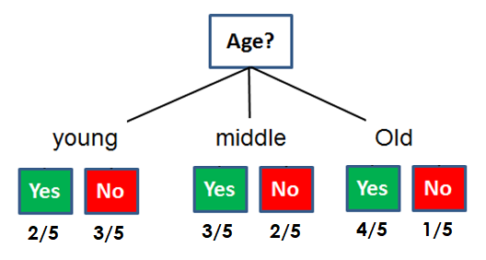
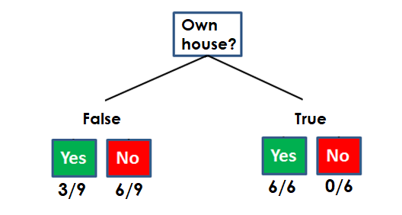
Rule Induction using Decision Tree
Decision Tree Algorithm – Which feature to select for split?
Which attribute is more intuitively for your to better/easier decision making?

Slide 8
Rule Induction using Decision Tree
Decision Tree Algorithm – ID3 Information Gain
ID3 algorithm
In decision tree learning, ID3 (Iterative Dichotomiser 3) is an algorithm invented by Ross Quinlan used to generate a decision tree from a dataset.
Information Gain formula:
  IG(DataSubsets|Attribute) = Imp(Initial Dataset) – Imp(DataSubsets|Attribute)

Slide 9

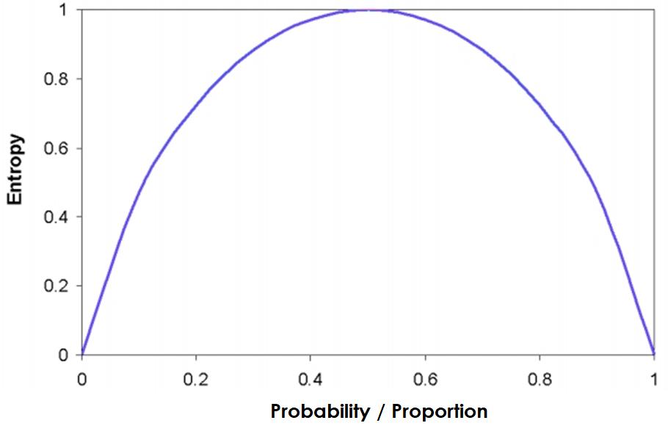
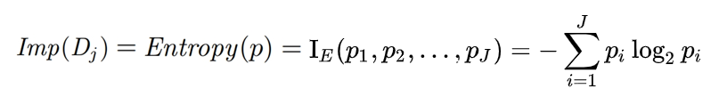
Rule Induction using Decision Tree
Decision Tree Algorithm – Initial Dataset Impurity
9 6
P₁(Yes) = 9/15
P₂(No) = 6/15
Imp(Initial Dataset) = - 9/15 log(9/15) - 6/15 log(6/15) = 0.5288 + 0.442 = 0.971

Slide 10
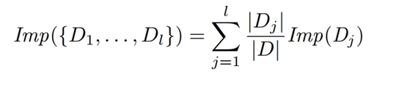
Rule Induction using Decision Tree
Decision Tree Algorithm – Data Subset Impurity by attribute split

Slide 11
Rule Induction using Decision Tree
Decision Tree Algorithm – Which attribute for conditional split?
Imp(Young) =
-2/5log(2/5)-3/5log(3/5)
= 0.5288 + 0.442
= 0.971
Imp(Middle)
= 0.971
Imp(Old) =
-4/5log(4/5)-1/5log(1/5)
= 0.2575 + 0.4644
= 0.722
Imp(False) =
-3/9log(3/9)-6/9log(6/9)
= 0.5283 + 0.39
= 0.918
Imp(True) =
-6/6log(6/6)-0/6log(0/6)
= 0 + 0
= 0
Total Imp(Age) = 5/15 x 0.971 + 5/15 x 0.971 + 5/15 x 0.722
= 0.3237 + 0.3237 + 0.2407 = 0.888
IG(D|Age) = Imp(Initial Dataset) - Imp(D|Age)
= 0.971 – 0.888 = 0.083
Total Imp(Own_house) = 9/15 x 0.918 + 6/15 x 0
= 0.551 + 0 = 0.551
IG(D|Own_house) = Imp(Initial Dataset) - Imp(D|Own_house)
= 0.971 – 0.551 = 0.42 ☺ The larger IG, the better attribute split !

Slide 12
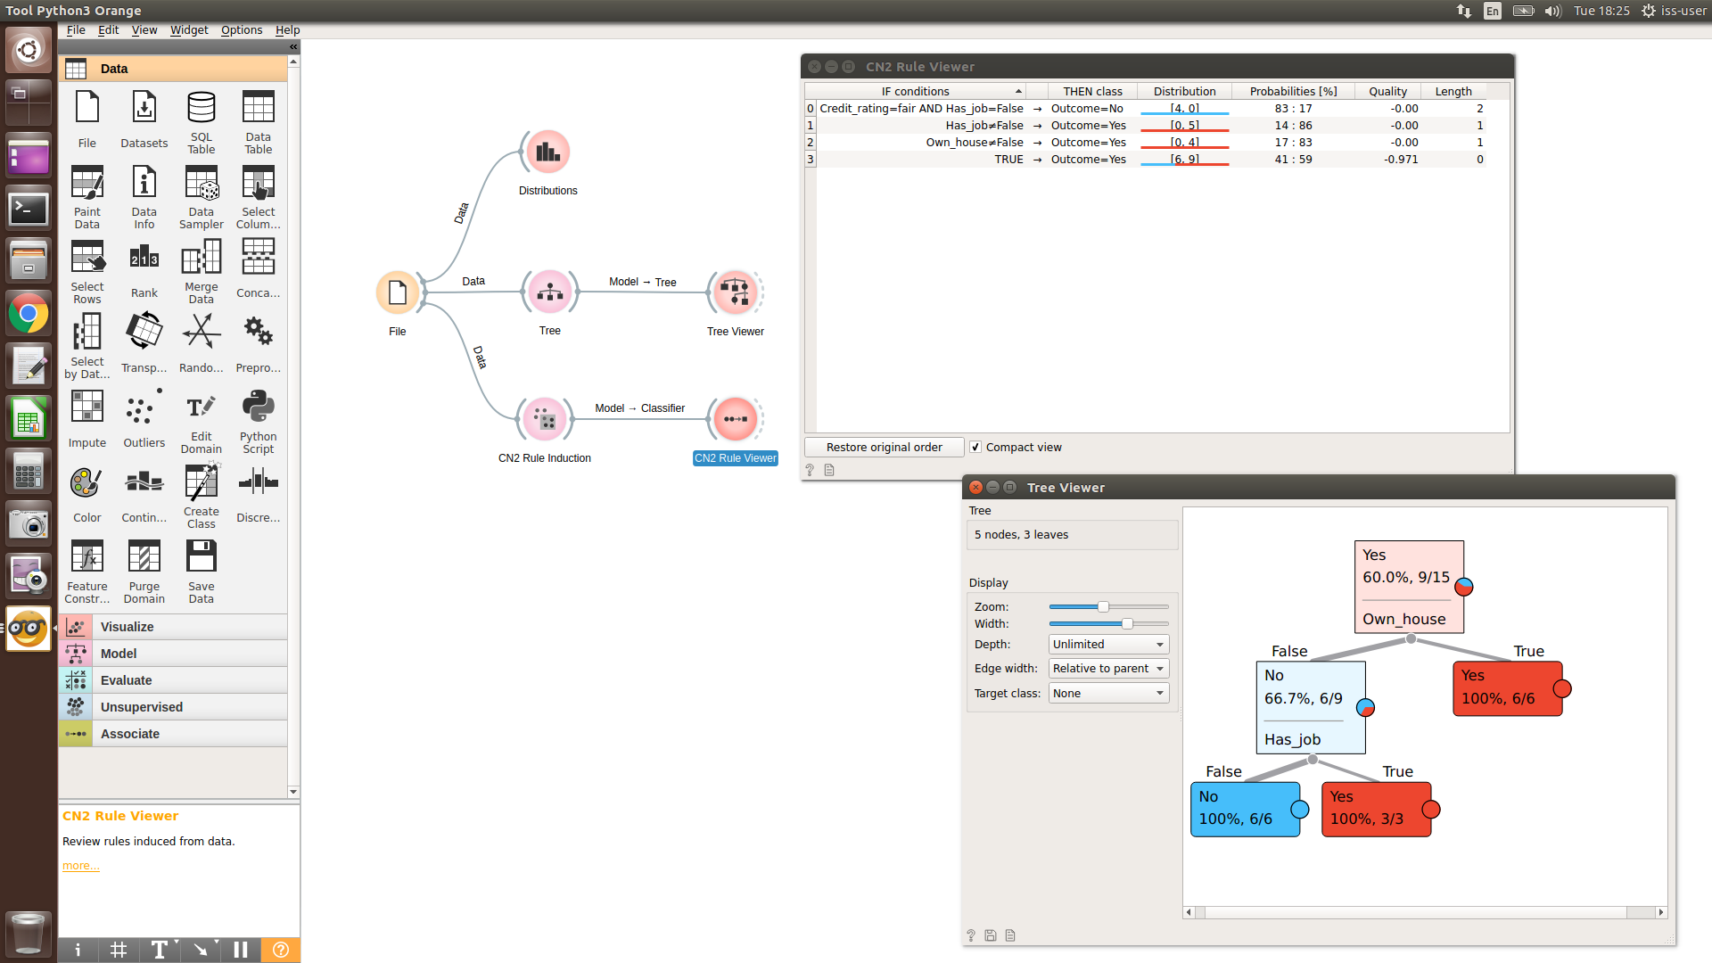
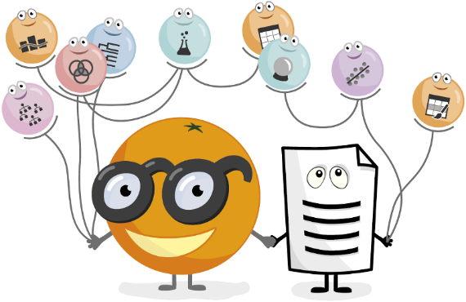
Rule Induction using Decision Tree
Data Mining Tool: Orange3 (python)

Slide 13
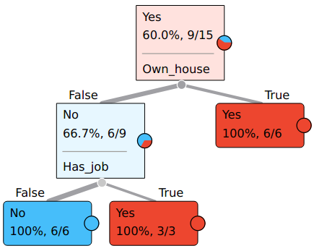
Rule Induction using Decision Tree
Orange3 Bank Loan Example – Decision Tree
R3
R2
R1
R3
R1
R1
R2
R3
R2
R3

Slide 14
Identify Aliens
14

Slide 15
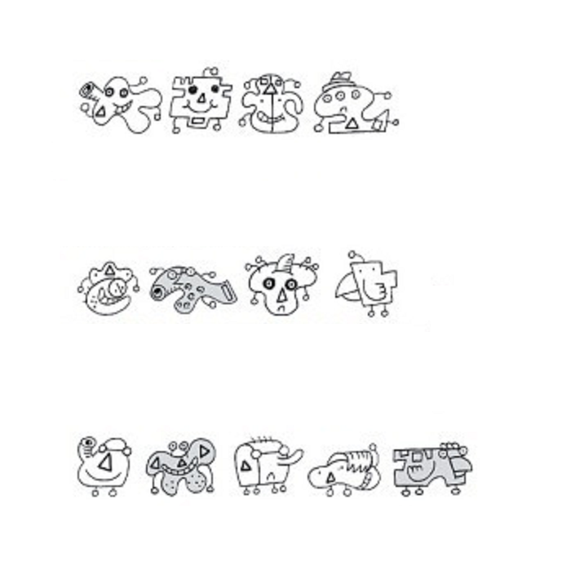
Exercise: Solve Problem using Your Cognitive Functions
Now, you have problem: spot the real alien.
What information/goal do you perceive from the left figure?
Any body feature of these creatures could you recognise?
What do you, as a problem solver, need to learn? Any common patterns of aliens?
When do you use your reasoning ability? What (inputs) do you need in order to reason? And what’s the output?
What action do you need to take after reasoning?
Aliens
Non Aliens
Which one is alien?
A B C D E
15

Slide 16
Solve Problem using Cognitive Functions
Perceive: Gather raw observable information, e.g. problem goal, type of known creatures, test creatures, decision/action required.
Recognise: Recognise patterns and decomposed relevant information, e.g. different colours, triangle#, teeth#, and any more you can recognise?
Learn: Invent hypothesis / candidate theories, e.g. hypothesis 1: alien must has eyes >=2 & not in grey & no horn. (From 8 individual creatures, their recognised features & target types to generalize/create new rules, which must be correct for the 8 creatures’ types, using supervised learning method.)
Reason: Use test data to evaluate all hypotheses / candidate theories to obtain correct knowledge. (Use A-E test creatures to filter out correct knowledge/rules which can classify 5 creatures into 1 alien 4 non-aliens. As well as the single predicated alien based on newly learnt knowledge considered correct.)
Act: Make choice, observe/bear consequences (scores).
Aliens
Non Aliens
Which one is alien?
A B C D E
16

Slide 17
Rule Induction using Decision Tree Identify Aliens
Aliens
Not aliens
Which one is alien?
A B C D E
Training Data
SN | Triangle | Antenna | Teeth | Eyes | Alien
1 | 1 | 3 | 1 | 2 | TRUE
2 | 1 | 3 | 0 | 2 | TRUE
3 | 1 | 3 | 1 | 2 | TRUE
4 | 1 | 3 | 0 | 3 | TRUE
5 | 1 | 2 | 1 | 2 | FALSE
6 | 0 | 3 | 0 | 3 | FALSE
7 | 1 | 6 | 0 | 2 | FALSE
8 | 0 | 3 | 0 | 2 | FALSE
Test Data
SN | Triangle | Antenna | Teeth | Eyes | Alien
A | 1 | 2 | 0 | 2 | FALSE
B | 3 | 2 | 1 | 2 | FALSE
C | 1 | 4 | 0 | 2 | FALSE
D | 1 | 3 | 0 | 2 | TRUE
E | 0 | 3 | 0 | 2 | FALSE

Slide 18
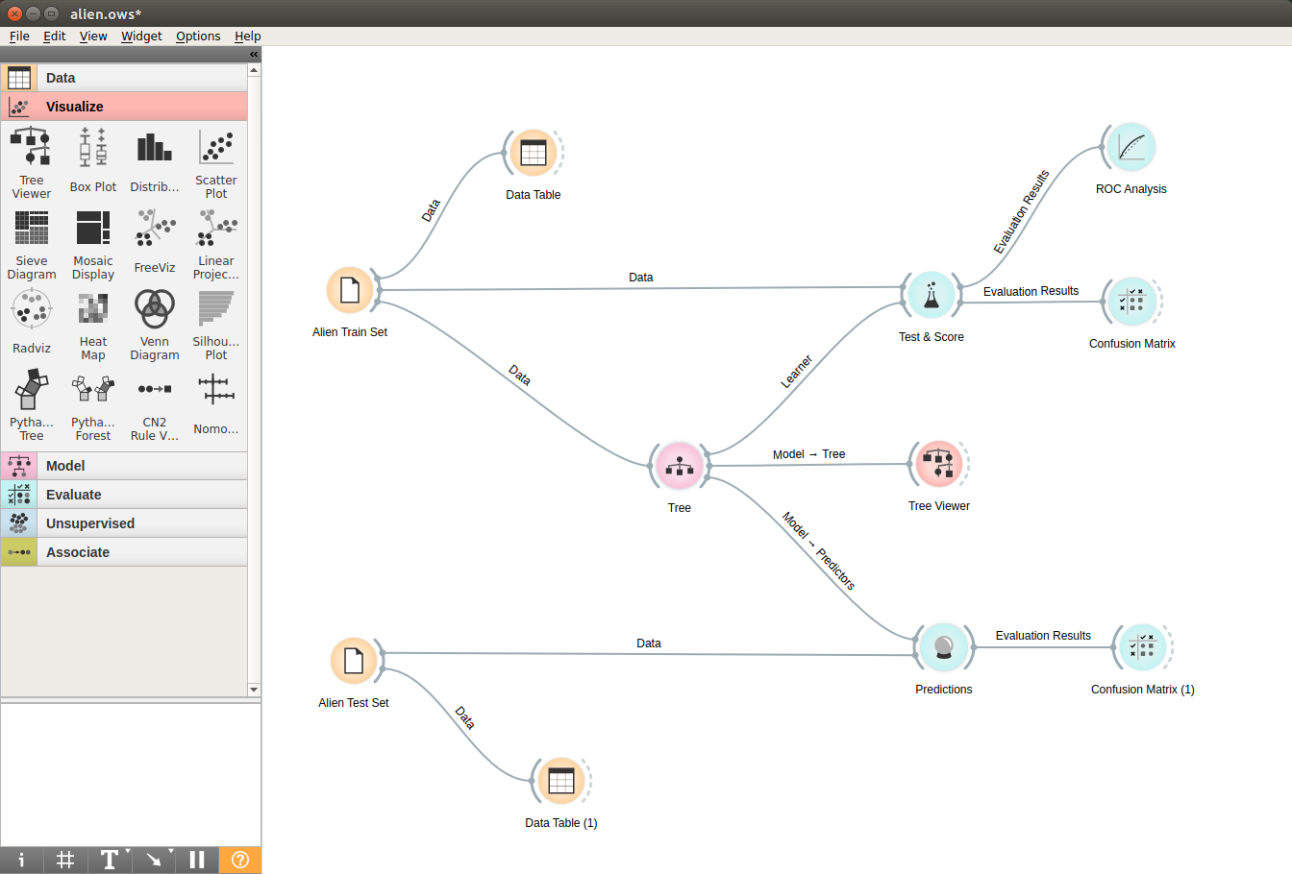
Rule Induction using Decision Tree Identify Aliens

Slide 19
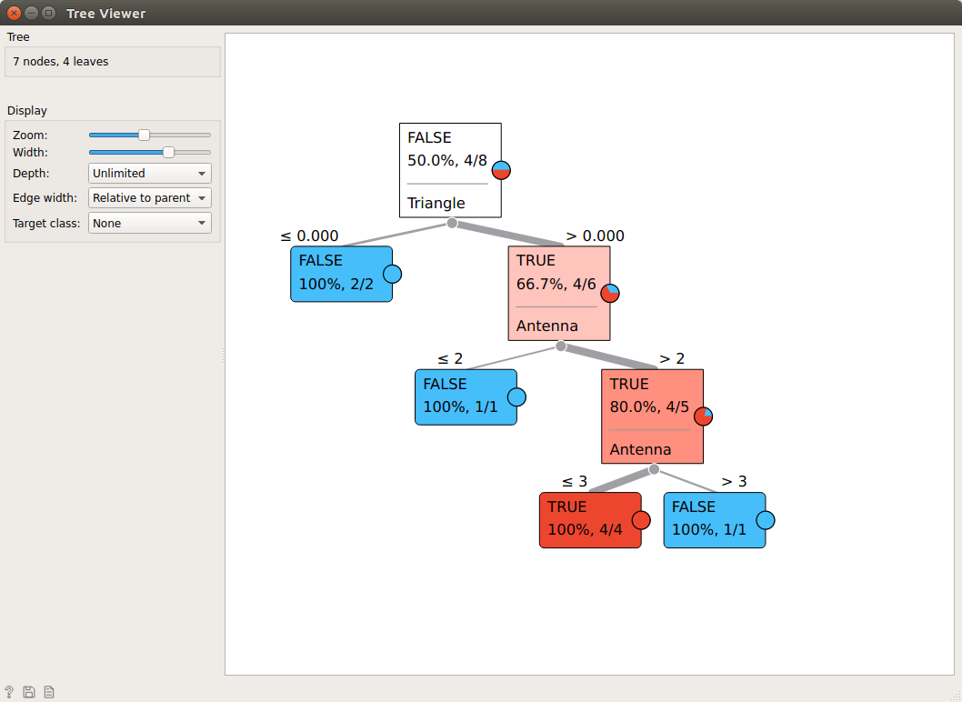
Rule Induction using Decision Tree Identify Aliens

Slide 20
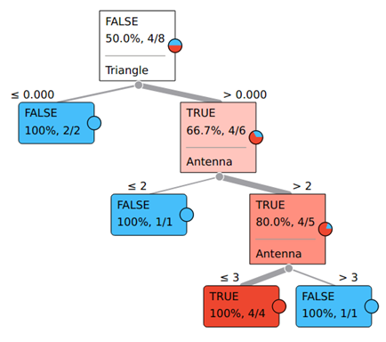
Rule Induction using Decision Tree Identify Aliens
Aliens
Not aliens
Which one is alien?
A B C D E

Slide 21
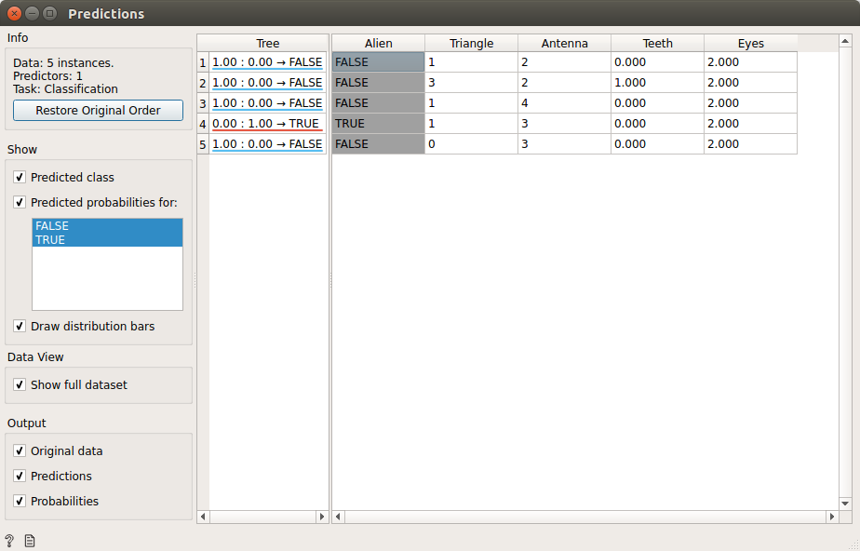
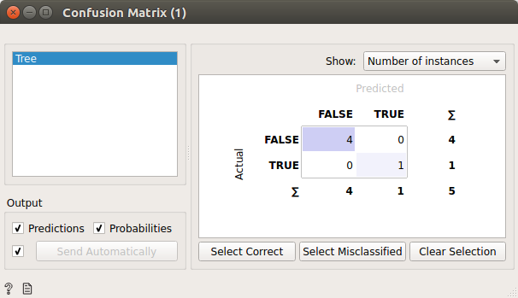
Rule Induction using Decision Tree Identify Aliens

Slide 22
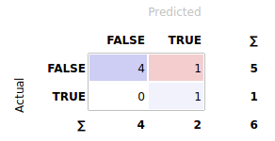
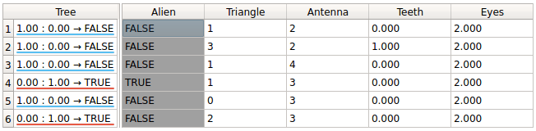

Rule Induction using Decision Tree Identify Aliens
Test Data
Aliens
Not aliens
Which one is alien?
A B C D E F
SN | Triangle | Antenna | Teeth | Eyes | Alien
A | 1 | 2 | 0 | 2 | FALSE
B | 3 | 2 | 1 | 2 | FALSE
C | 1 | 4 | 0 | 2 | FALSE
D | 1 | 3 | 0 | 2 | TRUE
E | 0 | 3 | 0 | 2 | FALSE
F | 2 | 3 | 0 | 2 | FALSE
The ‘black swan’: unseen before in historical data (no scenario/representation in training data)

Slide 23
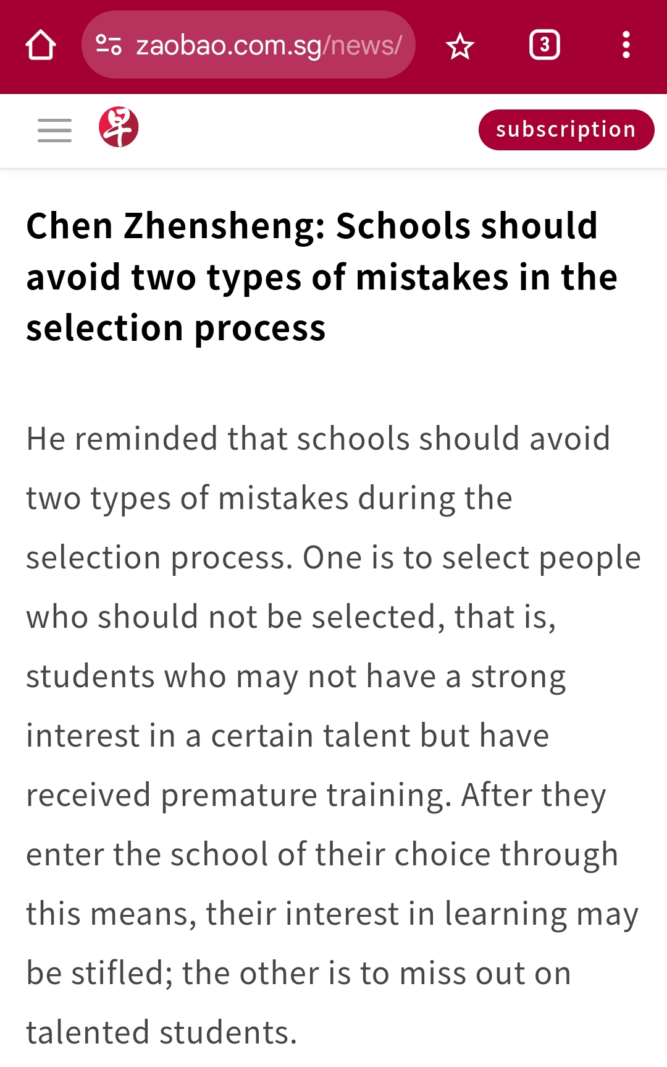
Which error type is mentioned by Ministry of Education?
  True Positive
  False Positive
  Ture Negative
  False Negative
Error 1 is:
Error 2 is:
Error 1
Error 2
23

Slide 24
The End, is the New Start.
24

